Slide 1









Banking
management

Slide 2









Introduction
This project presents a Banking Management System developed in C++. Designed to streamline essential banking operations, this system enables users to open, delete, and manage accounts, including Savings, Checking, and Business accounts. Security is ensured through PIN verification, and the system features error handling for a seamless user experience. With object-oriented principles, this system is modular and adaptable, providing a practical solution for small-scale banking needs.

Slide 3








Project overview
The project adopts an object-oriented design, ensuring flexibility and easy extensibility for future feature additions. The system is suitable for academic environments and small-scale banking applications, providing a solid foundation for further development.
This system allows users to perform several core banking operations such as:
•Account creation
•Account deletion
•Withdrawals
•Account searching

Slide 4






OBJECTIVES
COMPREHENSIVE ACCOUNT MANAGEMENT
Develop a structured system to create, manage, and track various account types (Savings, Checking, and Business), each with unique transaction rules and interest calculations.
SECURE AND ACCURATE TRANSACTION PROCESSING
Ensure secure handling of deposits, withdrawals, and transfers with accurate balance tracking and error-checking to prevent invalid operations.

Slide 5




methodology
The Banking Management System is developed in C++ using object-oriented principles to provide a modular, secure, and efficient framework for personal banking operations. The system employs a class-based structure where a base class Account encapsulates common attributes such as account holder’s name, balance, PIN, and account number. Derived classes (Savings Account, Checking Account, and Business Account) extend the base class, enforcing transaction rules specific to each account type, enhancing both functionality and modularity.
Algorithmically, each account is assigned a unique identifier upon creation, while transactions such as deposits, withdrawals, and transfers include balance verification and error handling. Financial features, such as loan repayment schedules and fixed deposit maturity values, are computed using standard interest formulas, allowing users to make informed financial decisions.

Slide 6
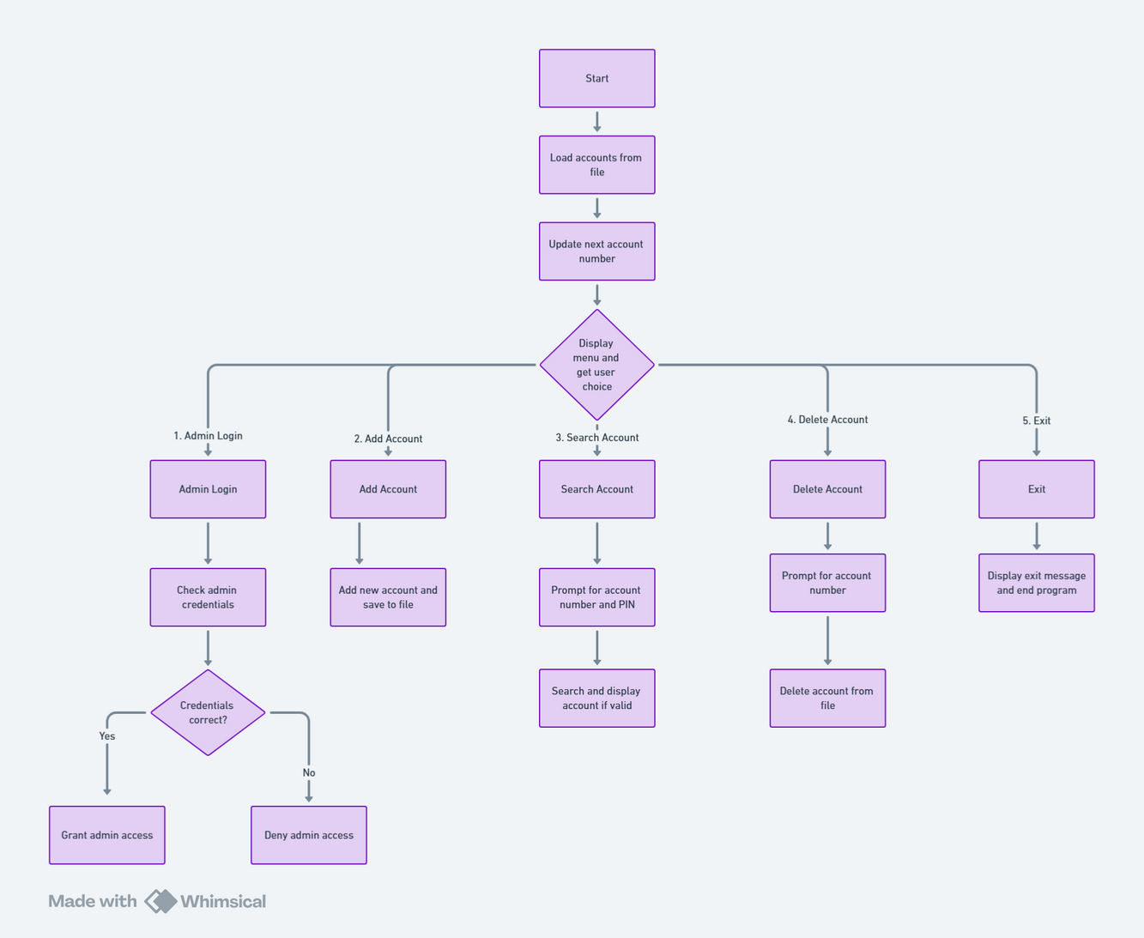
implementation

Slide 7
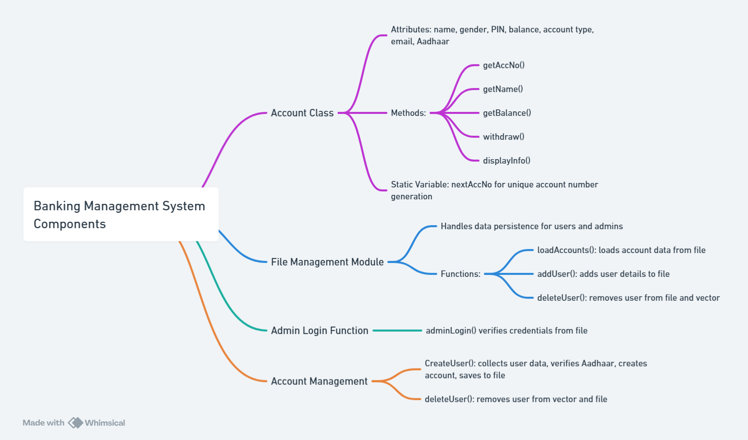
IMPORTANT MODULES IN CODE AND THEIR FUNCTIONALITY

Slide 8
admin login
Open admin file
Read storedUsername and storedPassword from file
Prompt user for username and password
If username and password match storedUsername and storedPassword
Display "Login Successful"
Return true
Else
Display "Invalid credentials"
Return false

Slide 9
create account
Prompt for name, gender, pin, initialDeposit, email
Display account type options
Prompt for account type choice
Set accountType based on choice (default to "Savings" if invalid)
Prompt for Aadhaar number
Validate Aadhaar number
Create new Account with entered details
Add new Account to accounts list
Open user file in append mode
Write new Account details to file
Display "User added successfully" and show account details

Slide 10

delete account
Prompt for account number to delete
Search for account in accounts list with matching account number
If account found
Remove account from accounts list
Open user file in write mode
Write all accounts to file
Display "User deleted successfully"
Else
Display "Account not found"

Slide 11
search account
Prompt for account number and pin
Search for account in accounts list with matching account number and pin
If account found
Display account details
Else
Display "User not found or PIN incorrect"
withdraw
Prompt for account number and pin
Search for account in accounts list with matching account number and pin
If account found
Prompt for withdrawal amount
If amount is valid and less than or equal to balance
Deduct amount from balance
Display new balance
Open user file in write mode
Write all accounts to file
Else if amount exceeds balance
Display "Insufficient balance"
Else Display "Account not found or PIN incorrect"

Slide 12









Results
The Banking Management System, implemented in C++, effectively meets its core objectives by providing functionalities like account creation, deletion, and transaction handling. Each account type, including savings, checking, and business accounts, was tested rigorously, and the system performed accurately and reliably in handling various transactions and scenarios. PIN verification and unique account numbers add security and usability.
The project demonstrates strong modularity through an object-oriented approach, facilitating future feature additions. Overall, this system serves as a practical model for basic banking management, with potential applications in small-scale operations or as a learning tool for students.

Slide 13
Conclusion
The project demonstrates C++’s capacity for managing financial transactions, making it an ideal educational tool for understanding fundamental software development in banking applications. While the command-line interface fulfills the basic requirements, future enhancements like a graphical interface and database integration could improve the system's usability and scalability. Database integration, in particular, would enable persistent data storage, providing users with consistent access to account information and transaction history.

Slide 14




Question time

Slide 15


Thank
you

